Slide 1
Selected 2
ArabicCharactersRecognition by CNN

Slide 2
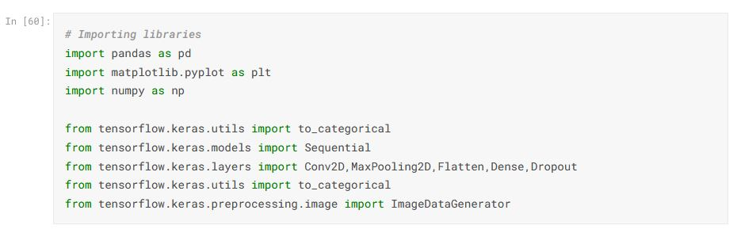
1-Import libraries

Slide 3
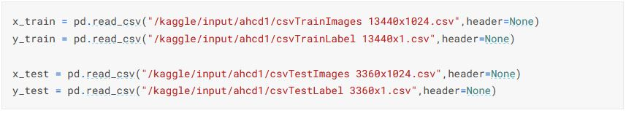
2-Set the dataset return datatable

Slide 4
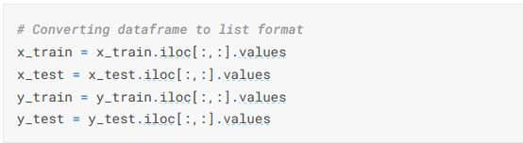
3-convert dataset from datatable to list

Slide 5
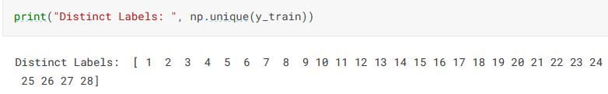
4-Show categories by y_train

Slide 6
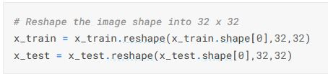
5- reshap the image shap into 32 x 32

Slide 7
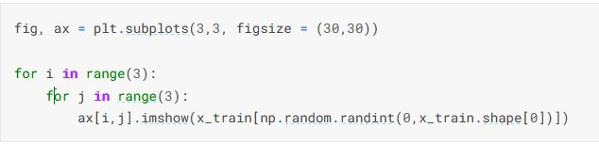
6- display images

Slide 8

7- Normalizing the data (color)

Slide 9

8- get total classes

Slide 10

9-reshap data to categorical by total classes

Slide 11
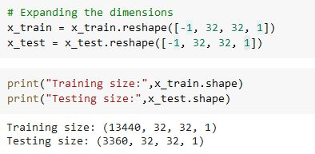
10- Expandind the dimention and reshap data

Slide 12
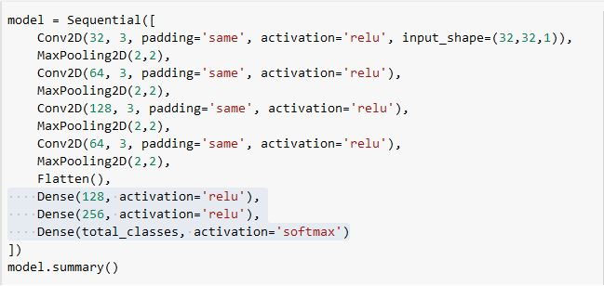
11-outfit or equip model ,I use sequential

Slide 13

12- use loss function (categorical Crossentropy)

Slide 14
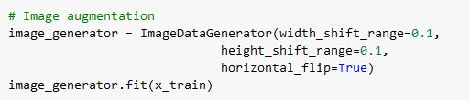
13-images augmentation

Slide 15
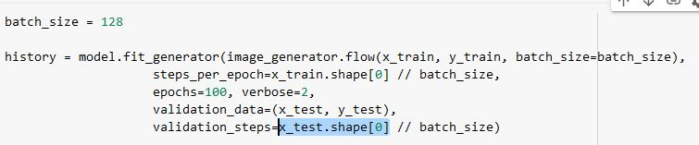

14- fit model and get accuracy

Slide 16
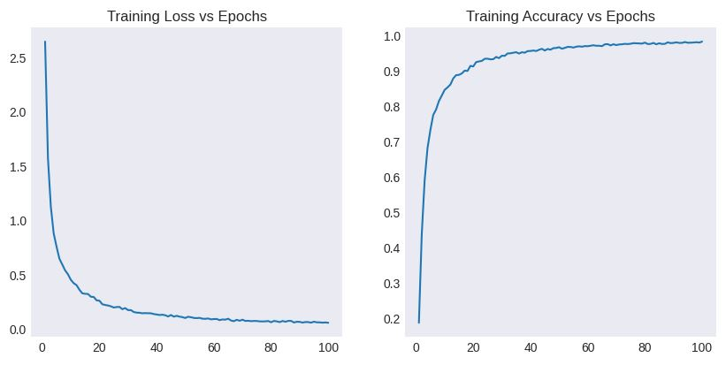
15-charts to train

Slide 17
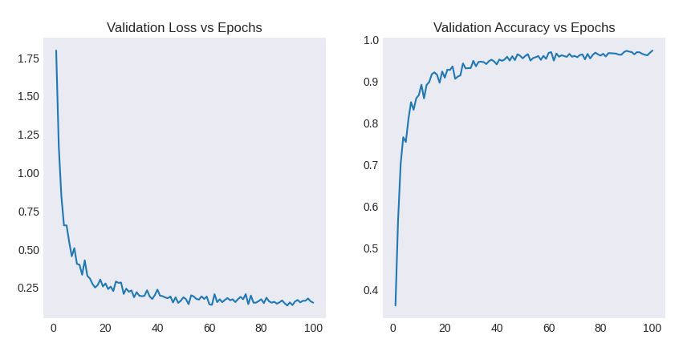
16-charts to validation

